Slide 1
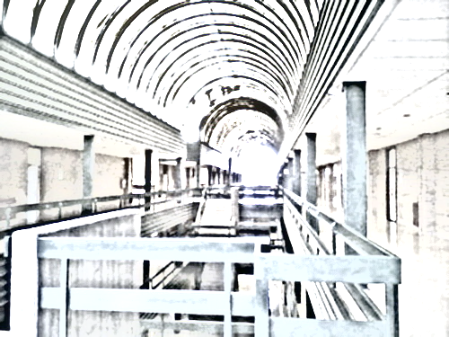
1992 - 1997
¿ Qué pasó ?
https://www.computerhope.com/history et al.

Slide 2
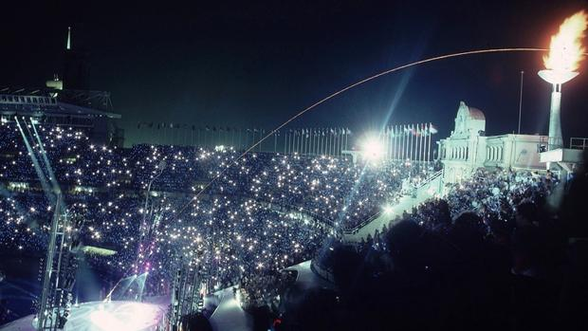
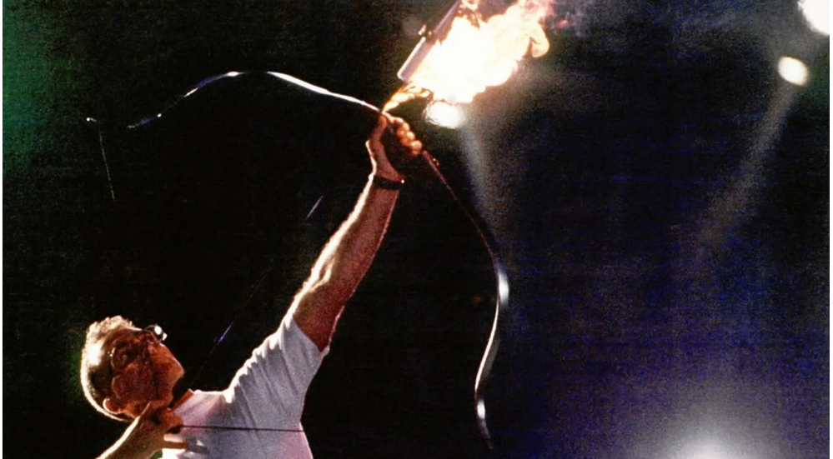

Slide 3
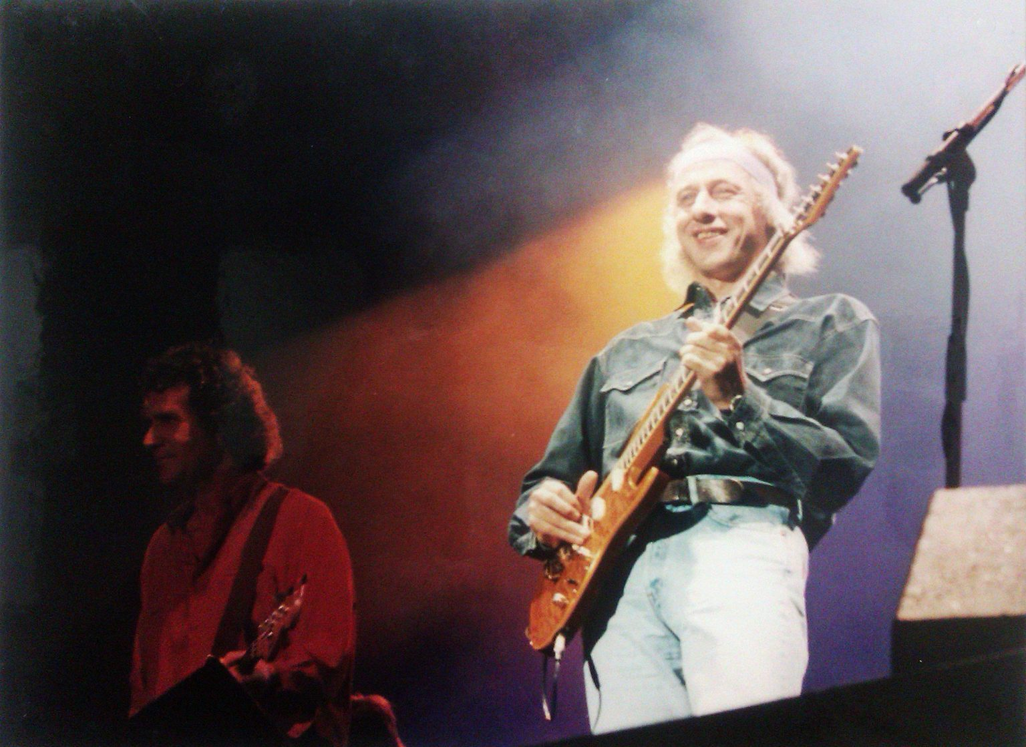
Dire Straits 9 de octubre de 1992 Estadio de la Romareda 40.000 espectadores

Slide 4
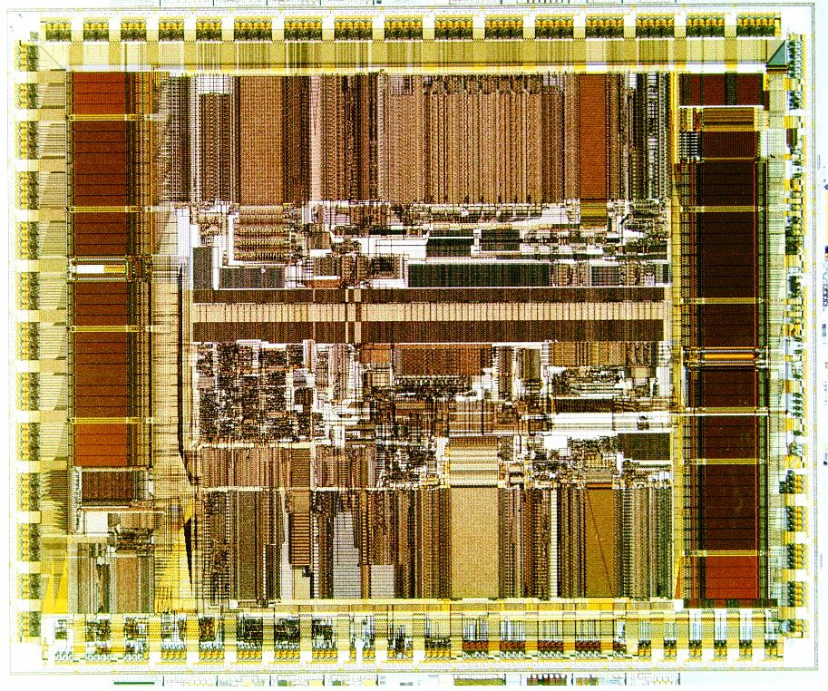
1992
Internet Society starts
Alpha 21064, Digital Equipment Corporation, the fastest 64-bit RISC architecture
PCI, Peripheral Component Interconnect, Intel
ThinkPad laptops, IBM
Windows 3.1, Microsoft
Linux is released under the GNU General Public License
SAP R/3, Systems Applications and Products in Data Processing /3 stands for three-tier client-server architecture
Nokia 1011 GSM

Slide 5
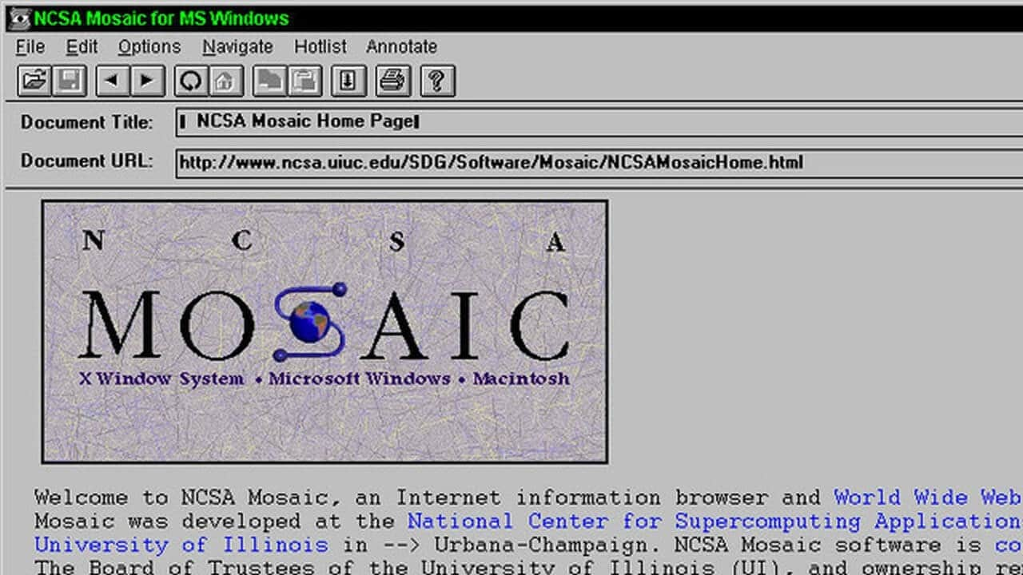
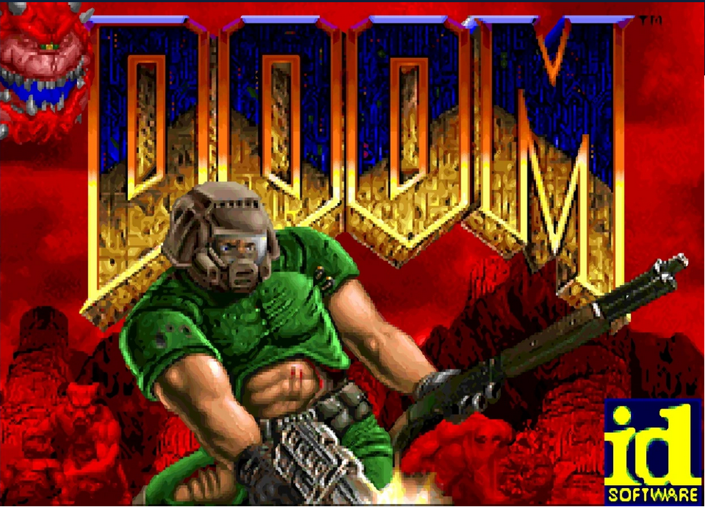
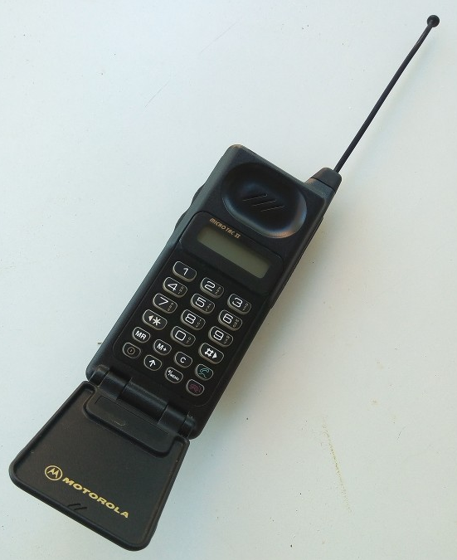
1993
Energy Star guidelines, Environmental Protection Agency
Intel Pentium, 5th gen x86, MMX, first superscalar, 60 MHz
PowerPC ISA by Apple, IBM and Motorola → Apple Power Mac (1994)
NCSA Mosaic internet browser, National Center for Supercomputing Applications, U. of Illinois
PC game DOOM by Id Software
NVIDIA and Supermicro starts
Motorola
Micro TAC II

Slide 6
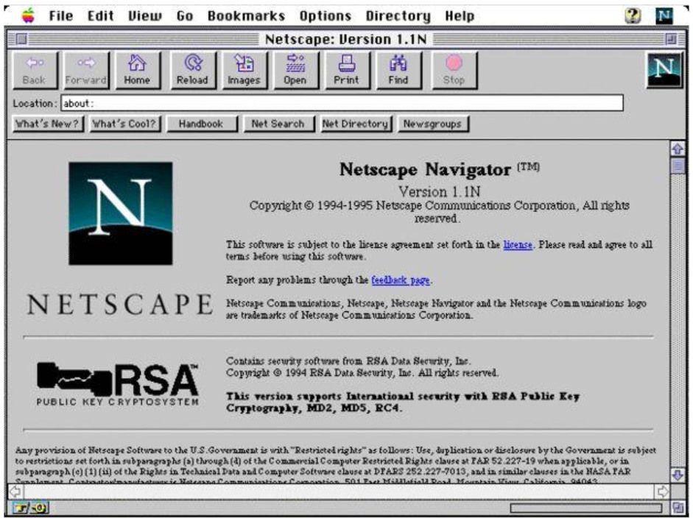
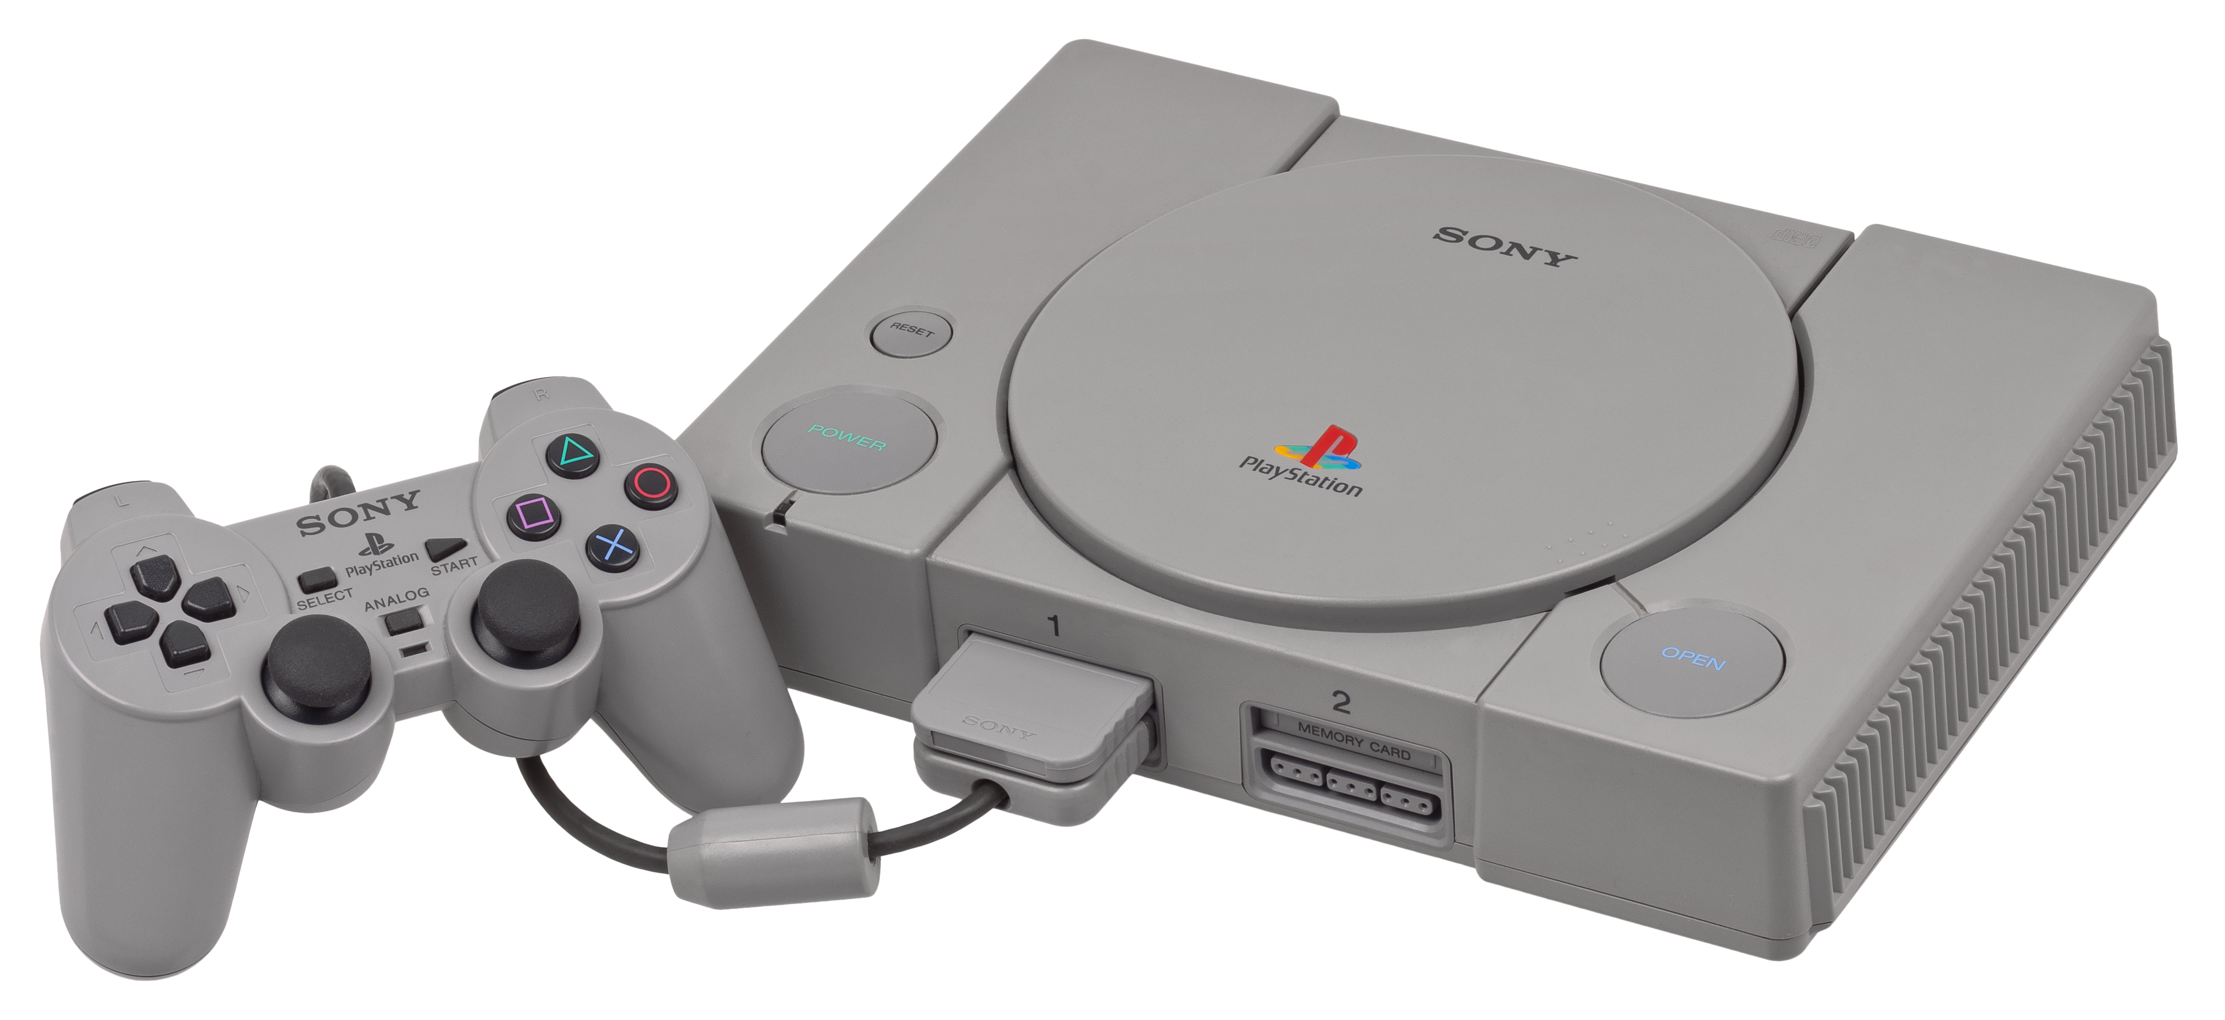
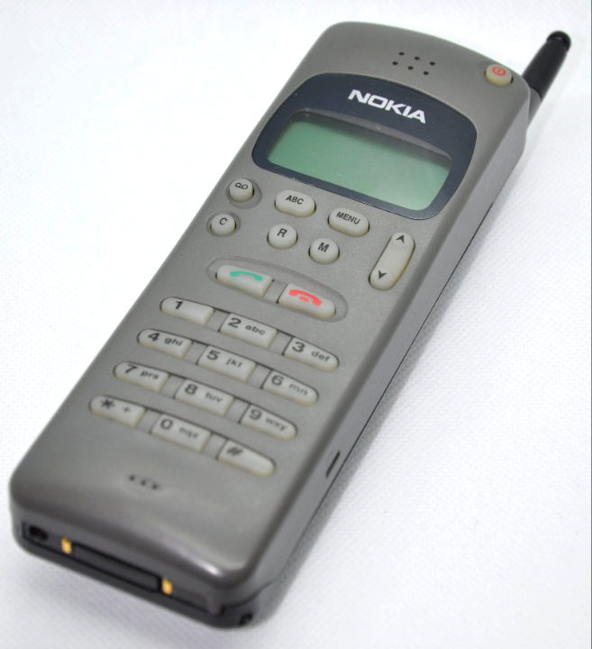
1994
W3C, World Wide Web Consortium, starts
SUSE Linux
Sony Playstation
Netscape 1.0 browser, rapidly growing body of Web surfers, introduced Internet cookies, Jim Clark & Marc Andreesen
Nokia
2010

Slide 7
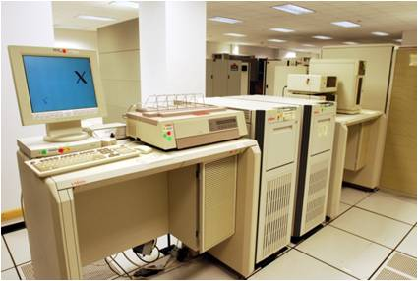
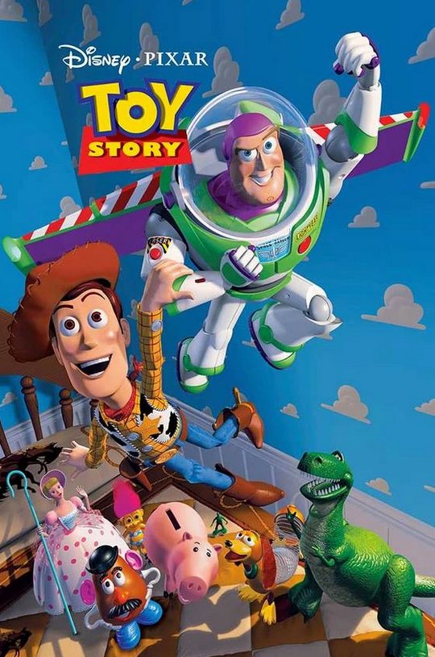
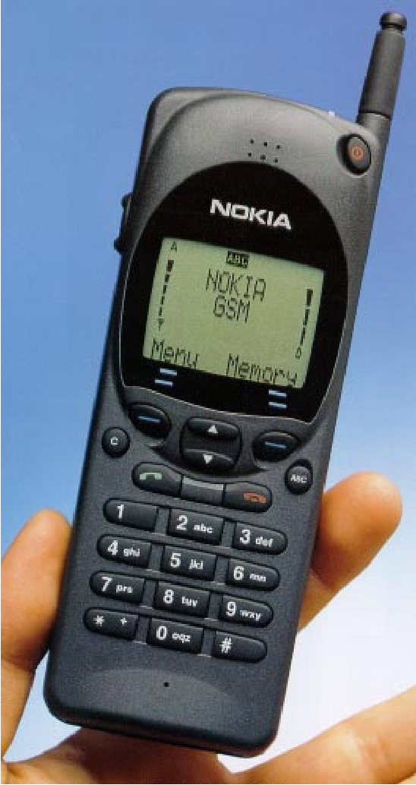
1995
Uptime Institute defines TIER-IV
Windows 95 and Internet Explorer 2.0
Red Hat Linux and company start
Java, James Gosling, Sun Microsystems
JavaScript, Brendan Eich
PHP, Rasmus Lerdorf
MySQL
Amazon.com, only books !
Toy Story, first full-length movie completely computer generated
Nokia 2110 GSM

Slide 8
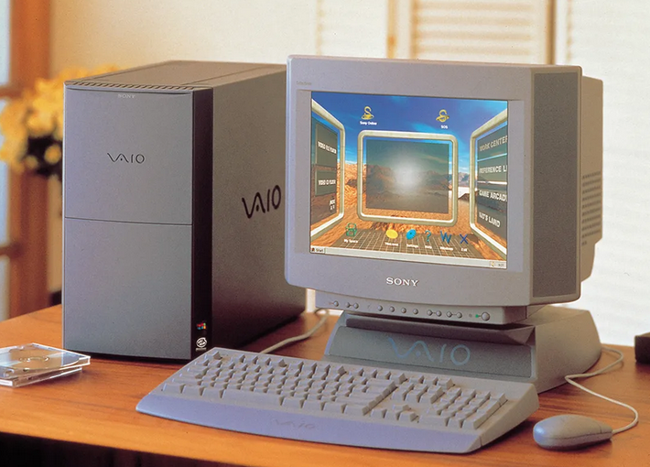
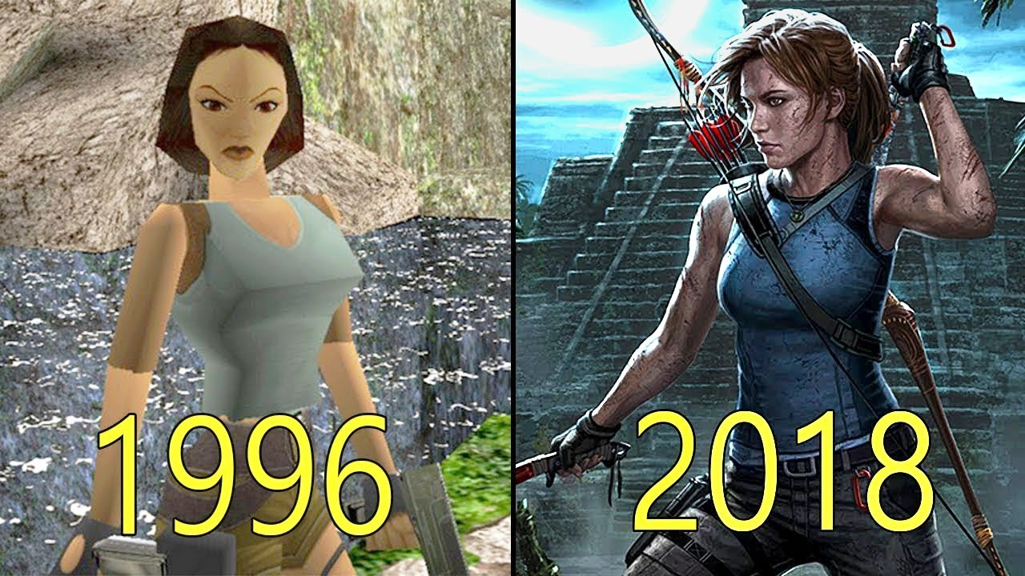
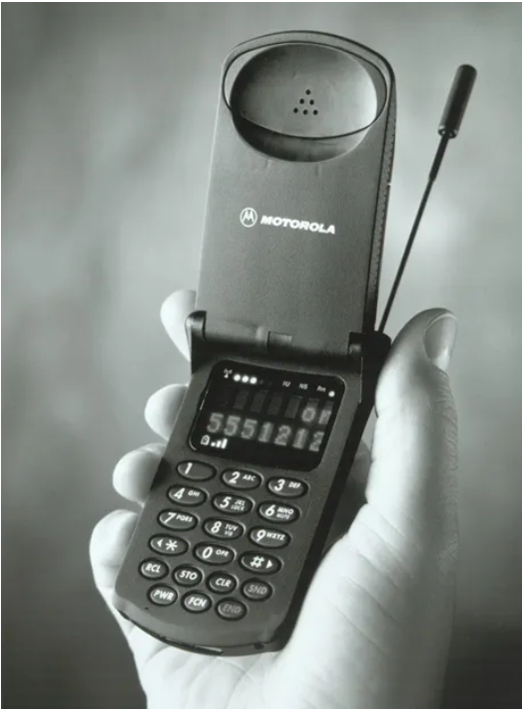
1996
K5 processor, first in-house AMD processor 75-133 MHz
USB cable and port specifications
IPv6 internet protocol
Sony Vaio desktops
Google search engine, Sergey Brin & Larry Page, Stanford University
First Tomb Raider game, Eidos
Motorola StarTAC

Slide 9
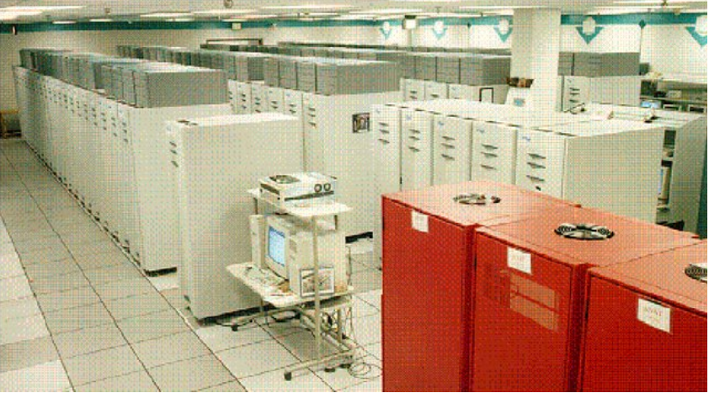
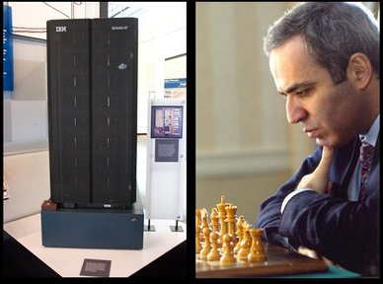
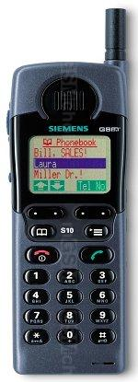
1997
Nathan Myhrvold, 1997, 1st law of software:
“Software is a gas It always expands to fit whatever container it is stored in”
ASCI Red supercomputer (Intel Paragon, built by IBM), Sandia National Laboratories. Fastest until 2000, 1.3 TFLOPS
802.11 the Wi-Fi network standard, IEEE
Fortran 95
IBM Deep Blue computer defeated Garry Kasparov
Netflix starts
Siemens S10

Slide 10
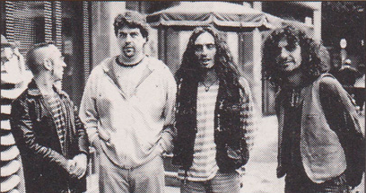
Platero y tu 7 de octubre de 1997 Pabellón Interpeñas

Slide 11
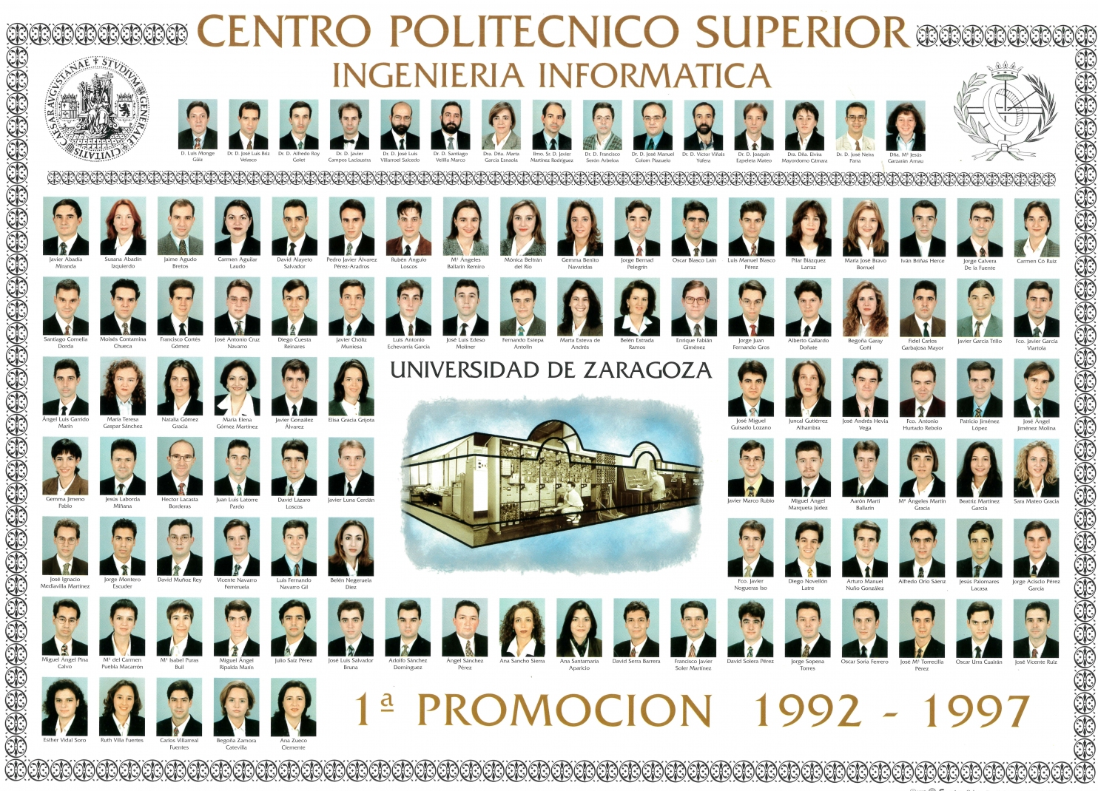
1992 - 1997
¿ Qué pasó ?
https://www.computerhope.com/history et al. 19 mayo 2023. Víctor Viñals Yúfera

